Slide 1

Hospital Management System
MEP 2.1 & 2.2
This is a progress presentation for chapter 1

Slide 2
Introduction [บทนำ]
Hospital management systems are systems that control, store and manage databases of information in the hospital.
Python is a dynamic, interpreted (bytecode-compiled) language. There are no type declarations of variables, parameters, functions, or methods in source code.
[ ระบบการจัดการโรงพยาบาลเป็นระบบที่ควบคุมจัดเก็บและจัดการฐานข้อมูลข้อมูลในโรงพยาบาล
Python เป็นภาษาแบบไดนามิกตีความ (bytecode-compiled) ไม่มีการประกาศตัวแปรตัวแปรพารามิเตอร์ฟังก์ชันหรือวิธีการในซอร์สโค้ด]

Slide 3
Brief history [ประวัติย่อ]
So many years ago, data storage and management was on old fashioned archives.
Old-fashioned archives take a lot of time and paper work.
Using the Python language will make finding the hospital information easier.
[หลายปีมาแล้วการจัดเก็บและการจัดการข้อมูลถือเป็นเรื่องเก่า ที่เก็บข้อมูลสมัยเก่าใช้เวลาและทำงานเกี่ยวกับกระดาษมากการใช้ภาษาไพ ธอนจะทำให้การค้นหาข้อมูลของโรงพยาบาลง่ายขึ้น]

Slide 4
Objectives [วัตถุประสงค์]
The objective of this project is to design a system that saves time on drug discovery and details such as drug name, type of medicine used, and so on.
[วัตถุประสงค์ของโครงการนี้คือการออกแบบระบบที่ช่วยประหยัดเวลาในการค้นหายาและรายละเอียดเช่นชื่อยาชนิดของยาที่ใช้และอื่น ๆ]

Slide 5
Description [รายละเอียด]
This Language used is python & Notepad++ to create a database of hospital management system.
[ภาษานี้ใช้ python & Notepad ++ เพื่อสร้างฐานข้อมูลของระบบการจัดการโรงพยาบาลเพื่อให้ง่ายต่อการจัดการฐานข้อมูลโรงพยาบาล]

Slide 6
Summary [สรุป]
Python languages can store large amounts of data. It is also easy to find information. And can be used to develop simple, not complicated.
[ภาษาไพธอนสามารถจัดเก็บข้อมูลจำนวนมากได้ นอกจากนี้ยังง่ายต่อการค้นหาข้อมูล และสามารถนำมาใช้ในการพัฒนาแบบเรียบง่ายไม่ซับซ้อน]

Slide 7
CHAPTER TWO
REVIEW OF RELATED LITERATURE

Slide 8
REVIEW OF RELATED LITERATURE
In this chapter, I will talk about the literature review of hospital management system.
I will also provide quotations on some related literatures including the authors and other details.
In this chapter I will also explain previous written theories about this project.

Slide 9
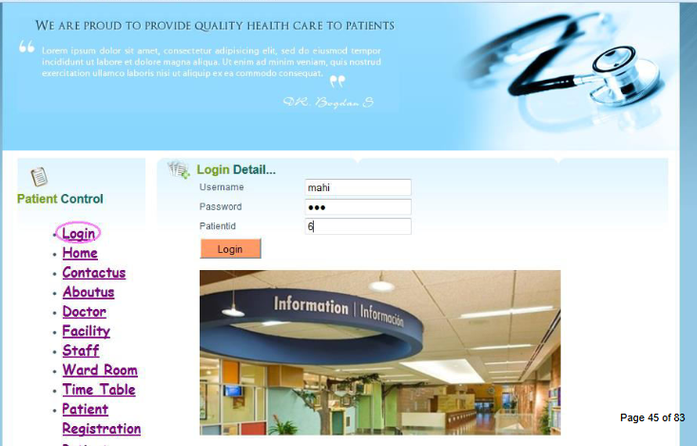
1. Website for hospital information system
Patel Mona S. , Patel Sweety R. Created a hospital information system project that uses Microsoft Visual studio and MySQL server to manage databases of a hospital, 27-07-2015
Website for hospital information system

Slide 10
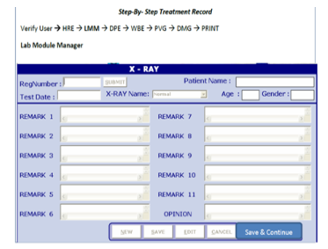
2. Design and Implementation of Hospital Management System
Adebisi O.A, Oladosu D.A The system solved the problems associated with the existing manual system. Security is also enhanced since access to the system requires authentication. 1, July 2015
Design and Implementation of Hospital Management System

Slide 11
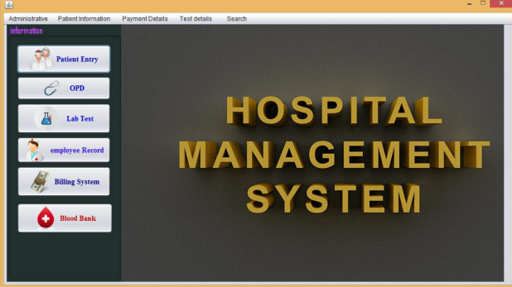
3. A PROPOSAL ON HOSPITAL MANAGEMENT SYSTEM
Paras Kumar Bishwakarma , Manish Upreti, Raju Kumar Yadav, Shreedhar Acharya This application contains login form, patient registration, doctor registration. Hospital Management application allow patients to edit their information like patient name, contact number, address, disease from which he is suffering from etc. 17th June 2014
A PROPOSAL ON HOSPITAL MANAGEMENT SYSTEM

Slide 12
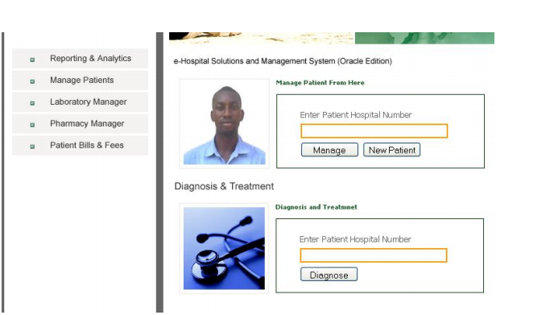
4. AUTOMATED HOSPITAL MANAGEMENT SYSTEM
OGBOBE NKECHI AGNES It is a software-based application to deliver operational speed and service efficiency in any target hospital. The project Automated Hospital Management System is very accurate in its approach and suits all environments including large, medium or small scale hospitals. MAY 2011
AUTOMATED HOSPITAL MANAGEMENT SYSTEM

Slide 13

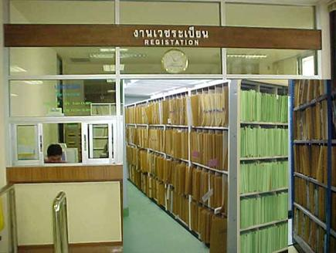
MEDICAL RECORD HOSPITAL MANAGEMENT SYSTEM
Huffman,E.K, From the patient's hospital records collected in the original paper file format. Data is saved Pet history History of treatment Incorporation of drug delivery records in a paper-based manner, resulting in poor data utilization, record keeping, and data retrieval. Stacked and lost. Published 2007

Slide 14
SUMMARY
Record quality medical records. Can be used as a complete medical proof. And can communicate the care information to the healthcare team for patient care planning. Therefore, the quality of medical records. It is therefore part of the medical records quality control system. It is a system for monitoring and analyzing qualitative medical records.

Slide 15
CHAPTER THREE
METHODOLOGY

Slide 16
3.1 Flowchart Bank Database Management System.
A flowchart is a type of diagram that represents an algorithm, workflow or process. The flowchart shows the steps as boxes of various kinds, and their order by connecting the boxes with arrows. This diagrammatic representation illustrates a solution model to a given problem. Flowcharts are used in analyzing, designing, documenting or managing a process or program in various fields.

Slide 17
3.1 Flowchart Bank Database Management System.
This is flow chart showing the flow of our Hospital management system it includes all the steps which the program goes through while interacting with a user. The program created will allow the user to input data about medicine, view the input medicine data, be able to add more medicine data as well as edit, delete and search through medicine. The whole program will be created with python programming language code Witten in Notepad ++ and displayed through CMD (command prompt)

Slide 18
Flowchart

Slide 19
These are the steps.
Step 1: Start Program
Open the program on the homepage will come out “Welcome to simple database program with python language” and choose an options.
Step 2: Choose an option
Choose an option you can choose different options from A-G

Slide 20
These are the steps.
Step 3: Perform task
a. Add: Function add you can Add id, name, type, size, usage, cure and choose m or t continue.
b. Show: Show information added to the add function.
c. Search: Finds the information we generate in the add function.
d. Edit: Edit data created in Add.
e. Delete: Delete data from created if not needed.
f. Exit: Back to menu
Step 4: End program
Close program.

Slide 21
3.2 SOFTWARE USED TO CREATE THE PROJECT
In this project the following software were used to create the project.
3.2.1 Notepad++
Notepad++ software was used as a platform to write python code, the python environment was activated on the Notepad++ using (-I “$(FULL_CURRENT_PATH)”) code

Slide 22
3.2.2 CMD command prompt
Cmd is a command that launches the Windows Command interpreter. It can run programs through text mode.
Usually, when we use Windows, it is usually used in graphical mode (GUI) mode. This GUI system allows us to do everything. To run a program Copy files or delete files. Via windows mode But the operating system has a mode called? Command Prompt? Or maybe it's called? Dos Prompt? This is a working mode in the text environment, which means that when to use any command. You have to type the command itself. This will be seen in many programs. And even some big programs. Can be run or configured when in Command Prompt mode.

Slide 23
3.3 PROGRAMMING LANGUAGES USED TO CRATE THE HOSPITAL MANAGEMENT SYSTEM PROJECT
In the project the following programming languages were used.
3.3.1 Python
Python is the language used to write a programming language. It was developed without being attached to the platform. The Python language is OpenSource like PHP, so everyone can use Python to develop our program. It's free and free of charge and is an open source, allowing people to help develop Python more advanced. And use it with all the job.

Slide 24
Generate code to add data.

Slide 25
Generate code to show data.

Slide 26
Generate code to search data.

Slide 27
Generate code to edit data.

Slide 28
Generate code to delete data.

Slide 29
Generate code to add more data.

Slide 30
CHAPTER FOUR
RESULTS AND DISCUSSION

Slide 31
4.1 Project performance.
Hospital Record System Project The purpose is to design and build programs. Hospital record system for project developers to use for their own learning more. The results are as follows.

Slide 32
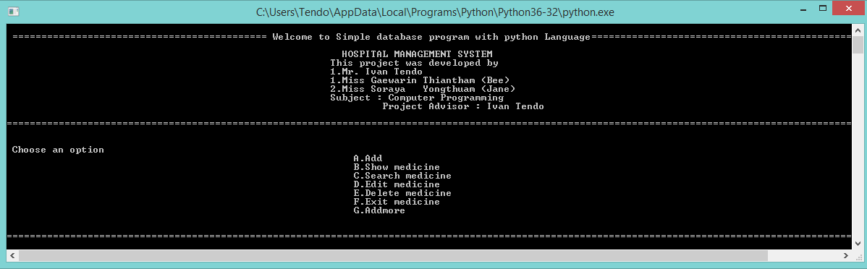
4.2 Results
Main Menu: This page shows information form authors and consultants. There are seven
Options on this page: Add data, Shoe data, Search data, Edit data, Delete data and Exit data.

Slide 33
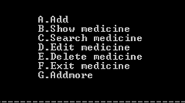
4.2.1 Main menu
Points that link important data. Compiled in the form of a menu button. Or messages that new content throughout.

Slide 34
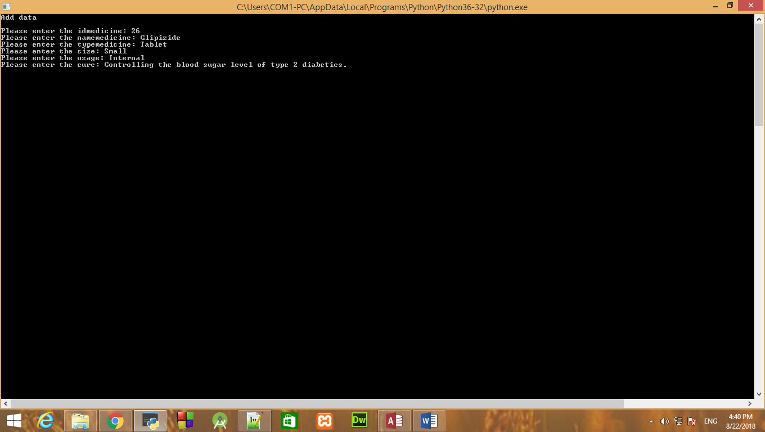
4.2.2 Add
Add medication information to the database.

Slide 35
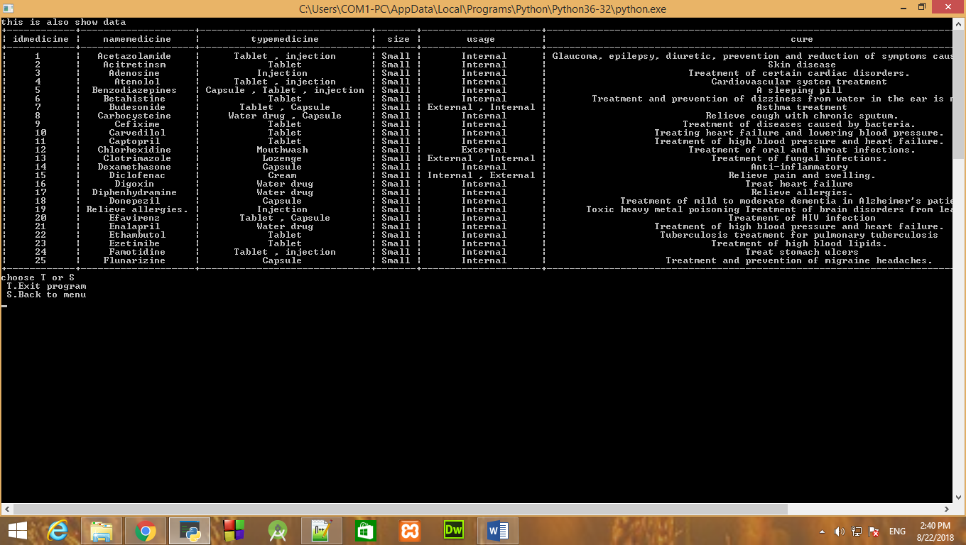
4.2.3 Show
Show all data in table format.

Slide 36
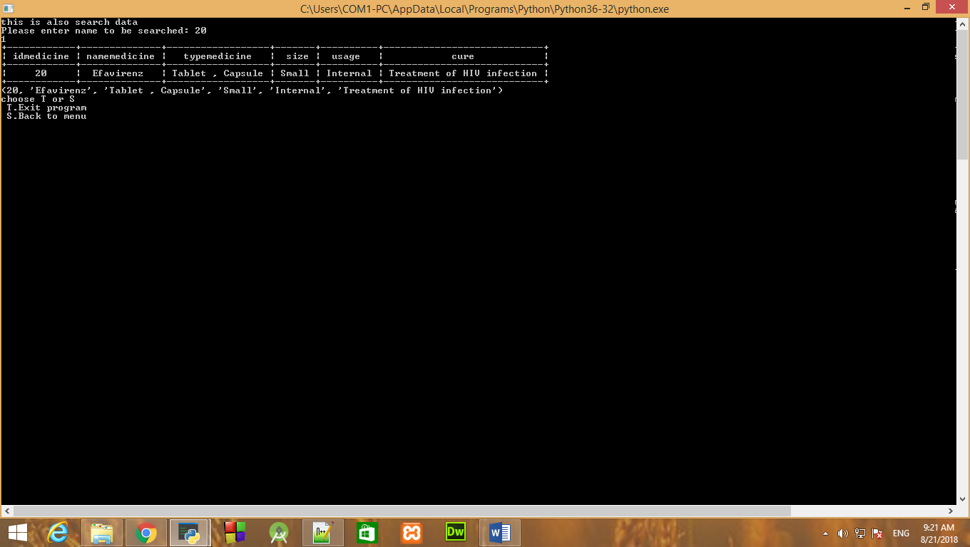
4.2.4 Search
Find the information you want to see.

Slide 37
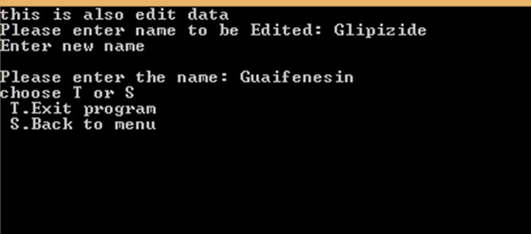
4.2.5 Edit
Used to modify the data in the database.

Slide 38
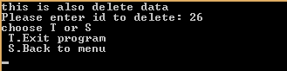
4.2.6 Delete
Used to delete unwanted data in the database.

Slide 39
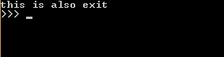
4.2.7 Exit
Work is finished.

Slide 40
CHAPTER FIVE
SUMMARY

Slide 41
SUMMARY
Record quality medical records. Can be used as a complete medical proof. And can communicate the care information to the healthcare team for patient care planning. Therefore, the quality of medical records. It is therefore part of the medical records quality control system. It is a system for monitoring and analyzing qualitative medical records.
Python languages can store large amounts of data. It is also easy to find information. And can be used to develop simple, not complicated.

